Slide 1

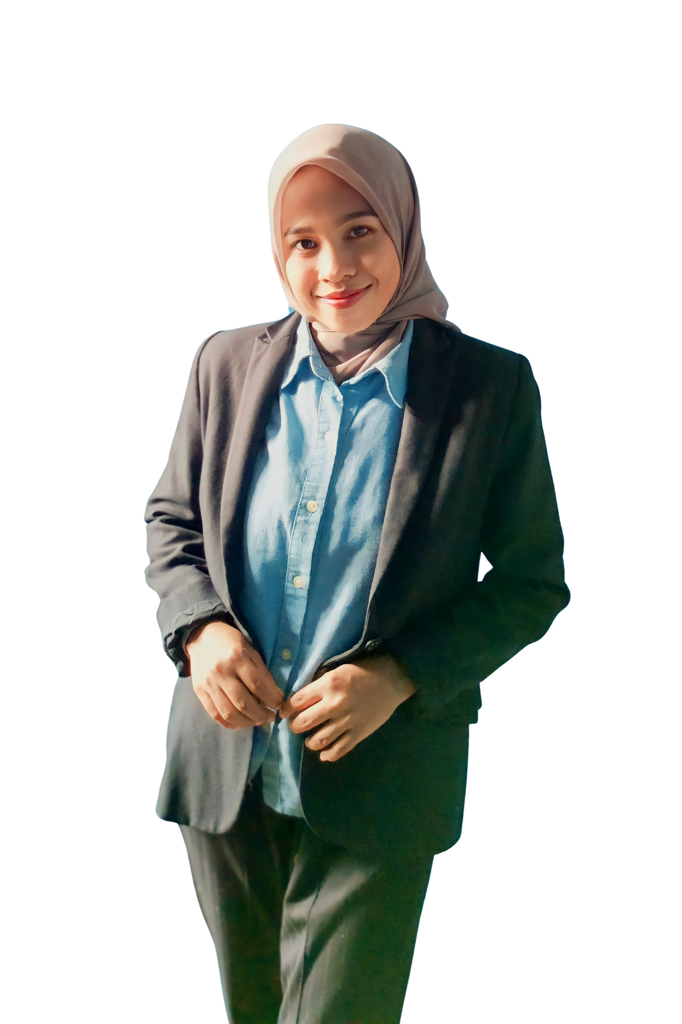
PORTFOLIO
PORTFOLIO
Industrial Engeneering
Fhahimatung,ST

Slide 2
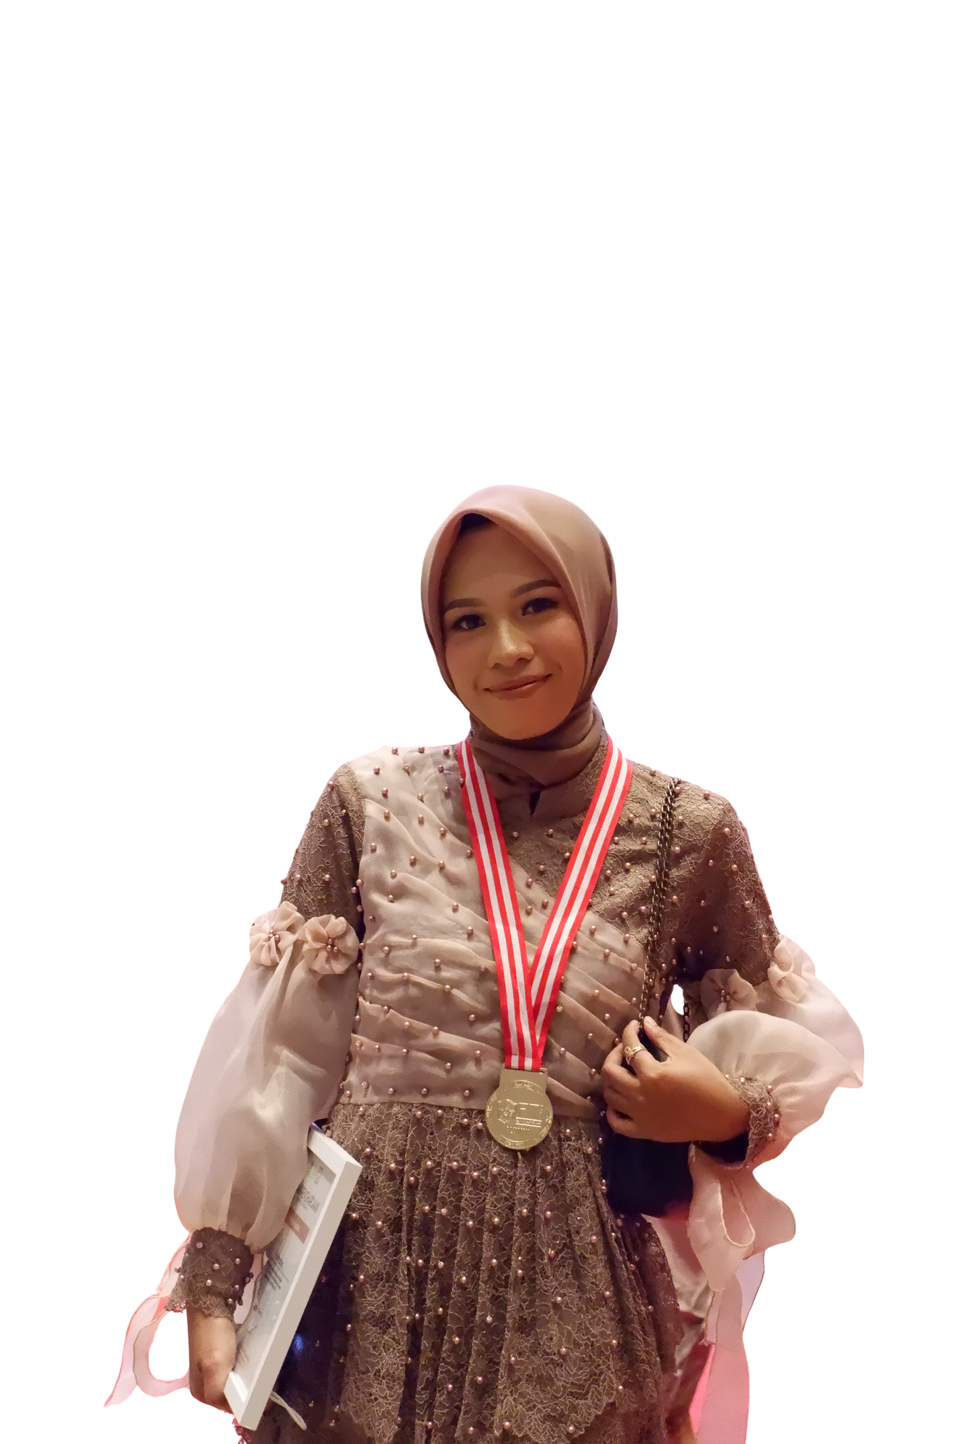

About Me
Education
Skills
Experiences
Organization
Project
Certificate
Contact
Saya merupakan lulusan Teknik Industri yang memiliki minat pada bidang Quality Control, inspeksi lapangan, K3, analisis data, dan administrasi. Saya memiliki pengalaman dalam pengawasan proyek elektrifikasi desa, pemeriksaan lapangan, pemantauan keselamatan kerja, dokumentasi, serta penyusunan laporan administrasi.
Saya adalah pribadi yang teliti, adaptif, dan memiliki semangat belajar yang tinggi. Saya berkomitmen untuk berkontribusi dalam meningkatkan efisiensi operasional, menjaga kualitas pekerjaan, serta menciptakan lingkungan kerja yang aman.

Slide 3
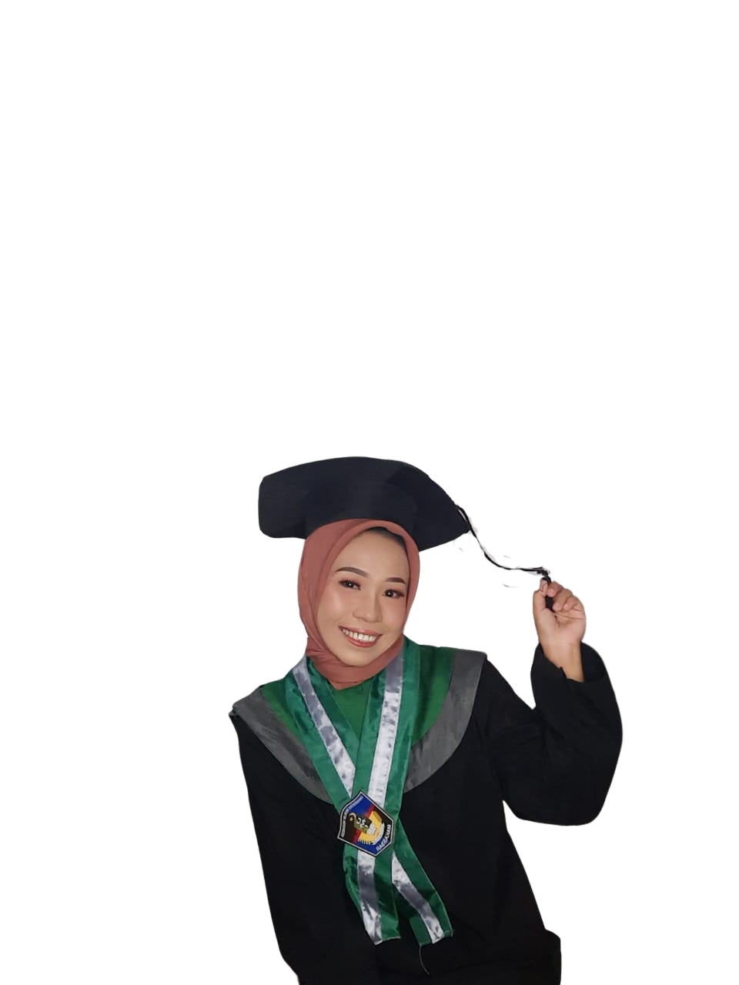
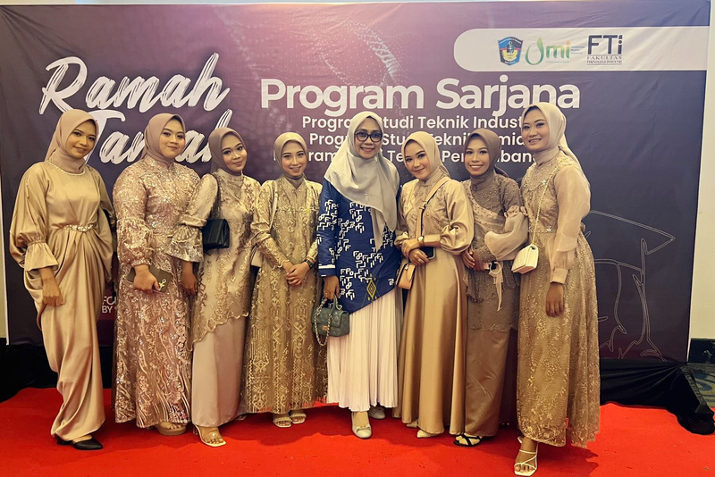
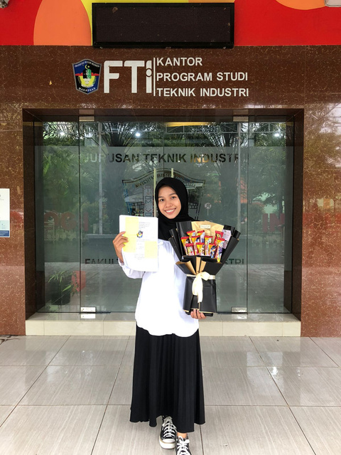
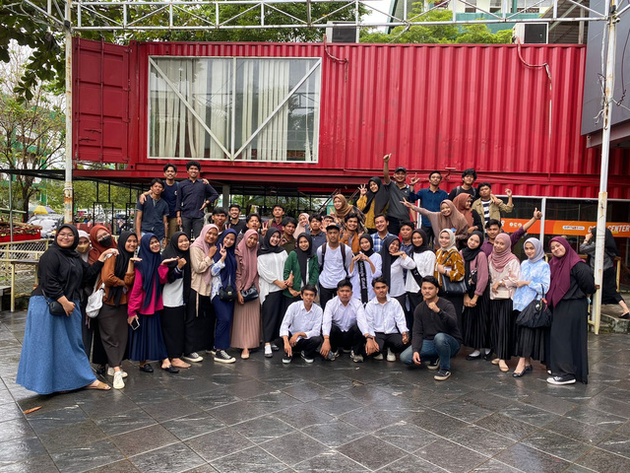
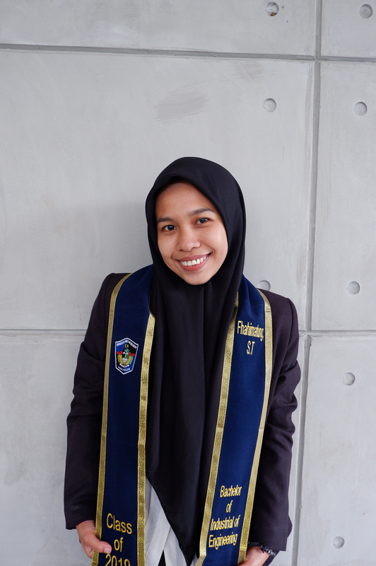
About Me
Education
Skills
Experiences
Organization
Project
Certificate
Contact
BACHELOR (S1) INDUTRIAL ENGINEERING
University Muslim Indonesia, Makassar, Indonesia
  GPA 3.76 / 4.0 September 2019—February 2023 (3,5 year)
  Task End about Analysis Human Factor dan Perbandingan Efektivitas Dalam Metode Konvensional Aplikasi Kinesiotaping dan Motor Relearning Pragramme (MRP) Dengan Menggunakan Pendekatan Biomekanika.
  Eye Studying Which relevant : Operations Research, Supply Chain Management, Quality Control, Lean Manufacturing, Simulation & Modeling, Project Management.

Slide 4
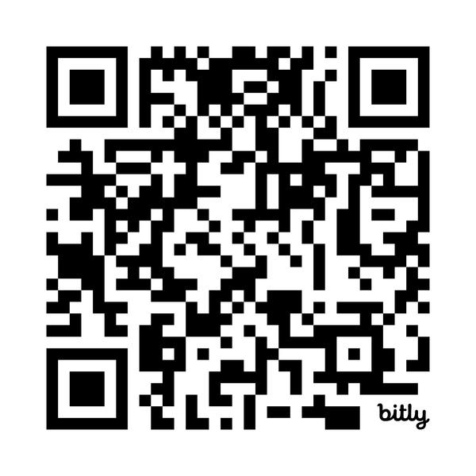













About Me
Education
Skills
Experiences
Organization
Project
Certificate
Contact
CURRIVULUM VITAE :
Hardskill
Quality Control & Quality Assurance
Data Analysis & Reporting
Occupational Health & Safety (K3)
Production Planning & Scheduling
Process Improvement
Field Inspection & Documentation
Supply Chain & Inventory Management
Project Administration & Monitoring
Softskill
Click or scan this to see my curriculum vitae
Analytical Thinking
Teamwork & Collaboration
Adaptability
Problem-Solving
Attention to Detail
Coordination & Organization
Interest & Expertise
  Industrial Engineering
  Manufacturing & Production
  Quality Control
  Supply Chain Management
  K3/HSE
  Field Inspection & Supervision
  Data Analysis
  Project Administration
Communication
Time Management
Software

Slide 5
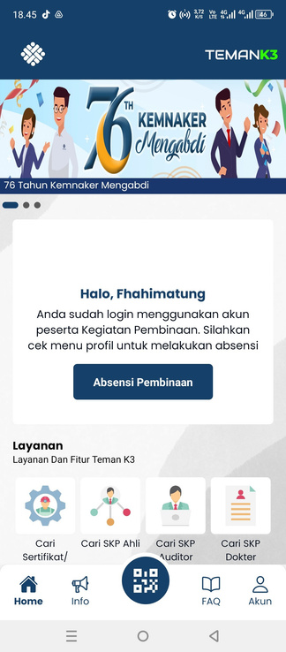
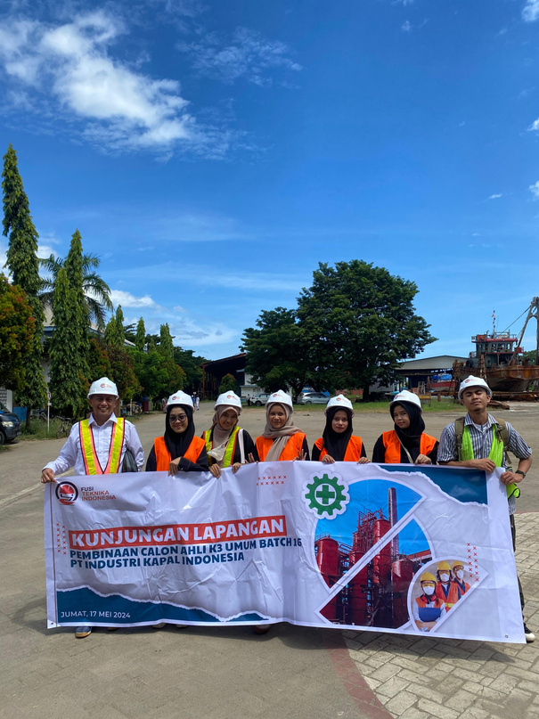
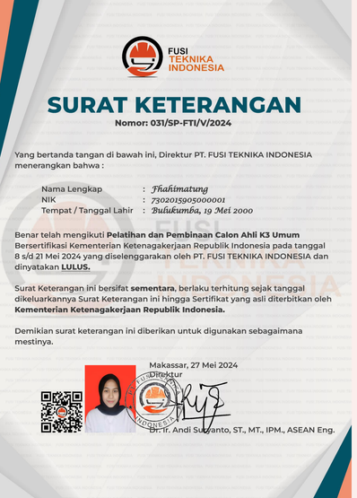
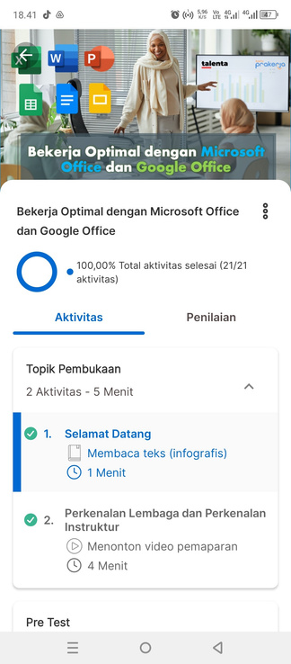
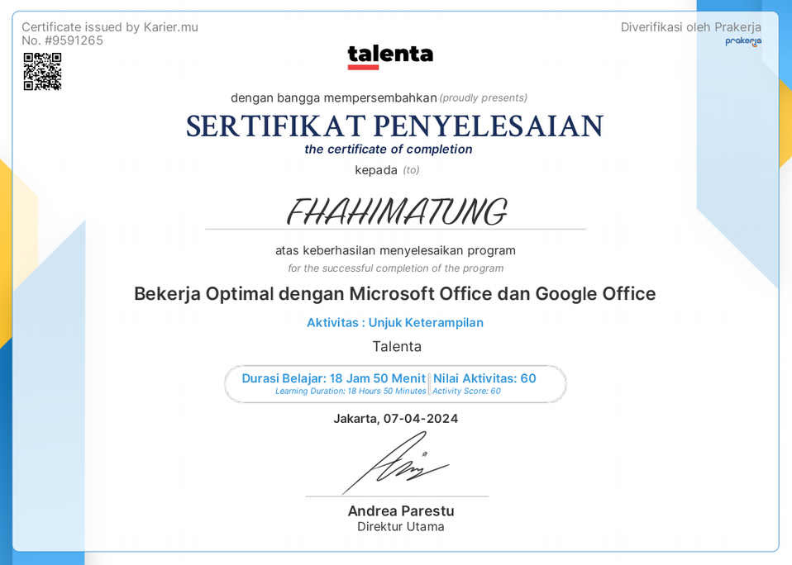
About Me
Education
Skills
Experiences
Organization
Project
Certificate
Contact
TRAINING DAN CERTIFICATION
Pelatihan K3 UMUM
  Penyelenggara : PT Fusi Indonesia / PT Fusi Teknika Indonesia
  Tahun: 2024
  Kompetensi: Keselamatan dan Kesehatan Kerja (K3)
Google & Microsoft Office
  Penyelenggara: Talenta ID
  Kompetensi: Microsoft Office, Google Workspace, dan pengolahan data

Slide 6
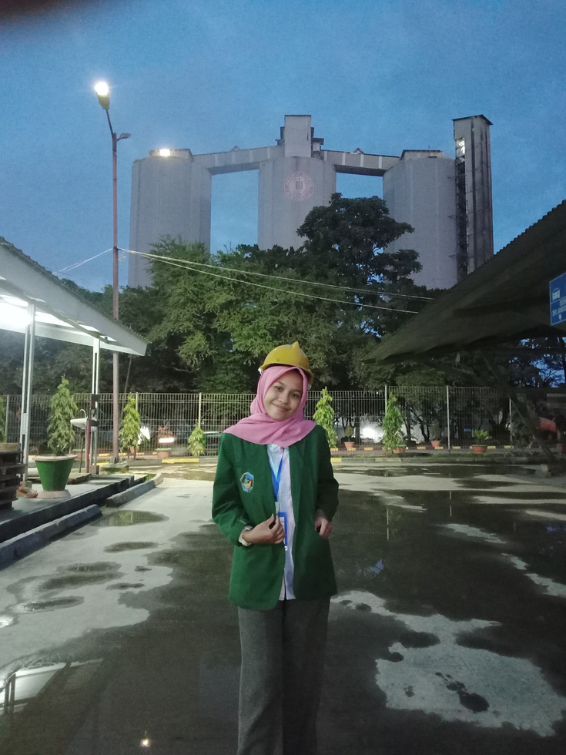
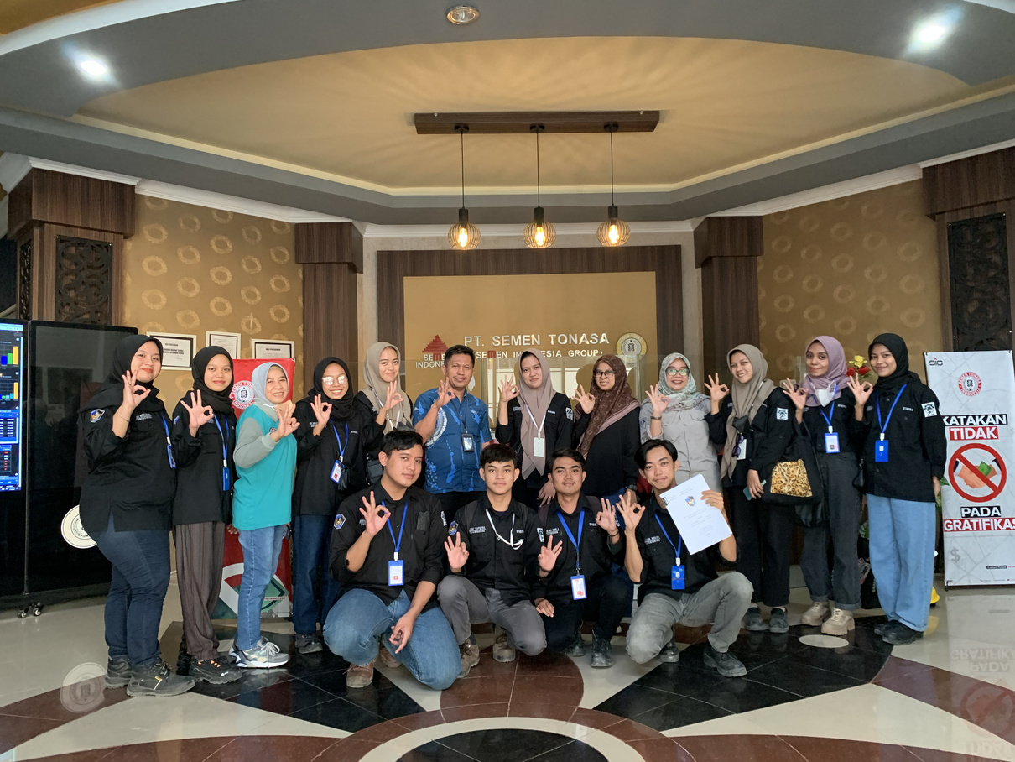
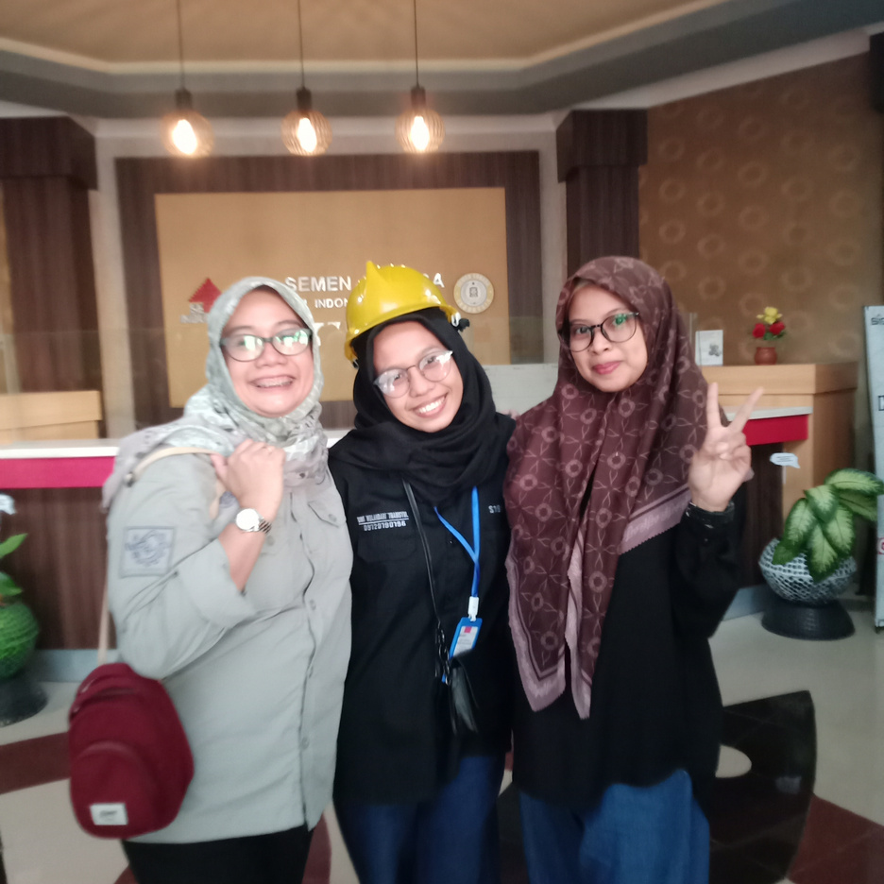
About Me
Education
Skills
Experiences
Organization
Project
Certificate
Contact
Intenship Safety, Health & Environment (HSE)
PT Semen Tonasa
  Assisted in monitoring and evaluating workplace safety and environmental compliance.
  Supported the implementation of Occupational Health and Safety (OHS) programs and training. June 2022—August 2022
  Contributed to documentation and reporting of safety inspections and environmental management. Collaborated with the HSE team to promote a safe and eco-friendly work culture.

Slide 7
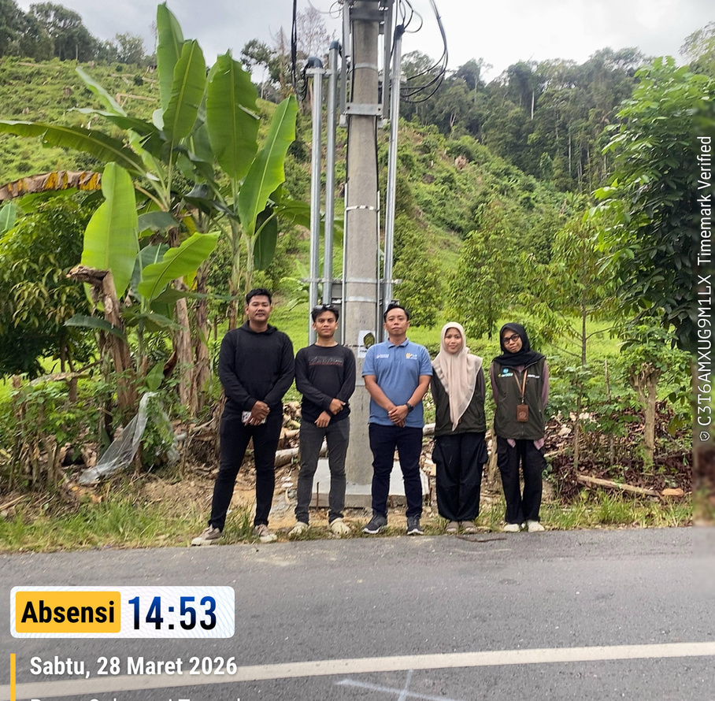
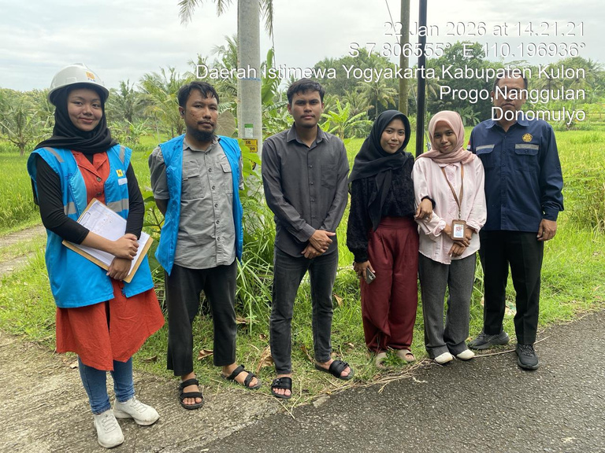
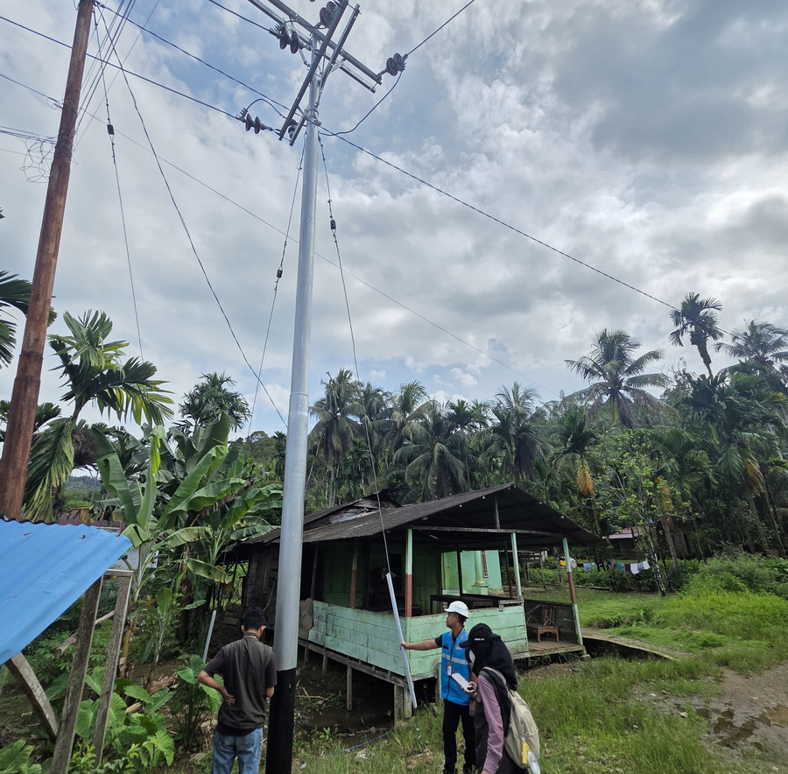
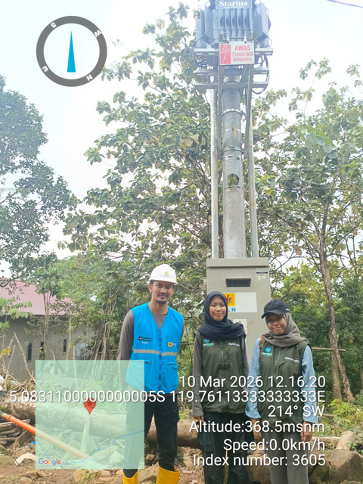
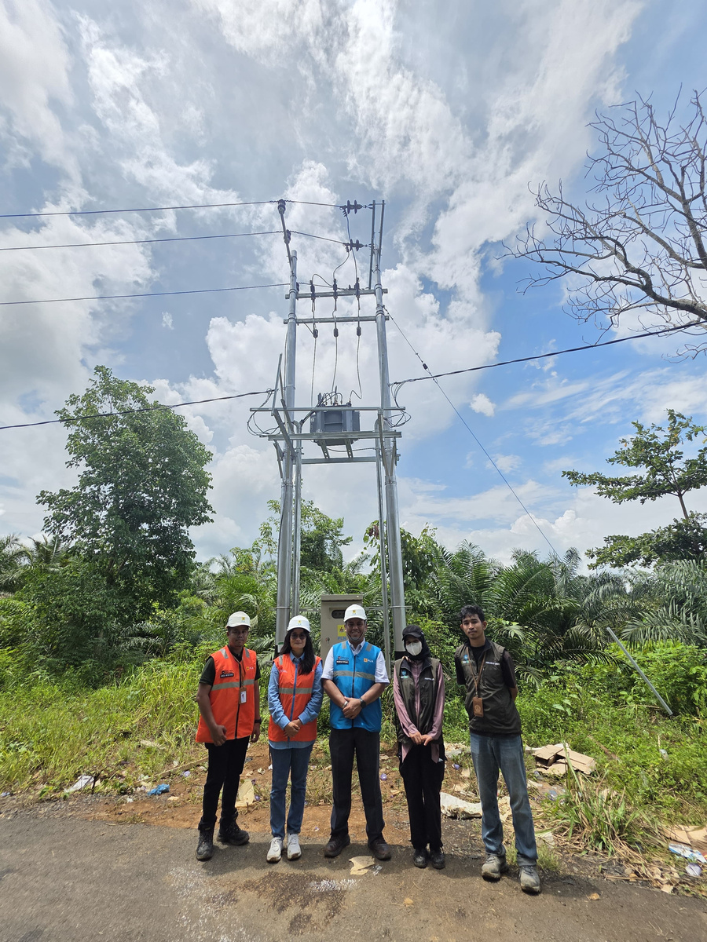
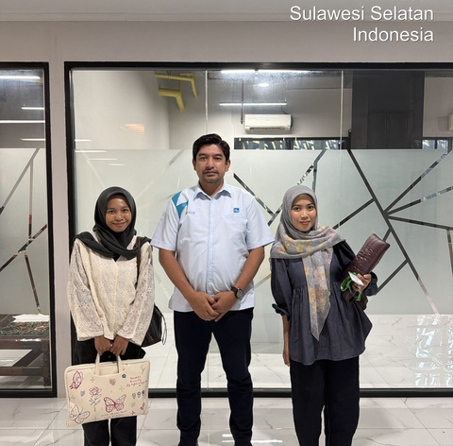
About Me
Education
Skills
Experiences
Organization
Project
Certificate
Contact
PENGAWAS LISTRIK DESA
Balai Besar Survei dan Pengujian (BBSP) KEBTKE
  Oversaw rural electrification projects under the Listrik Desa (Lisdes) program, ensuring compliance with ESDM regulations and technical standards.
  Conducted on-site inspections of electrical installations, poles, cables, and materials to ensure quality and safety.
  Identified and mitigated technical risks while enforcing Electrical Occupational Health and Safety (OHS) standards.
  Coordinated with contractors and stakeholders, and prepared progress and supervision reports.

Slide 8

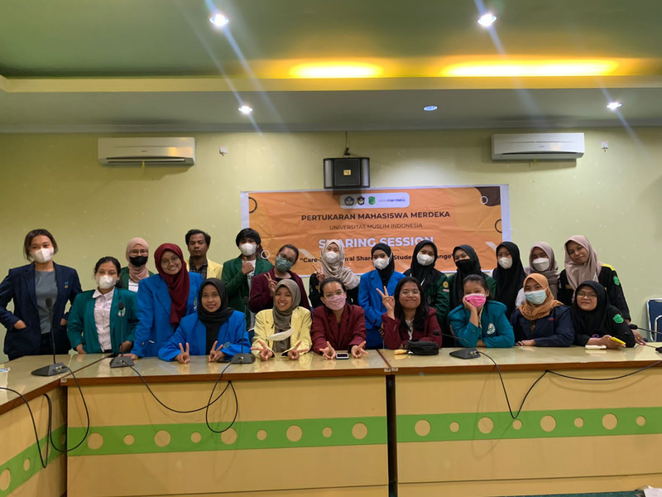
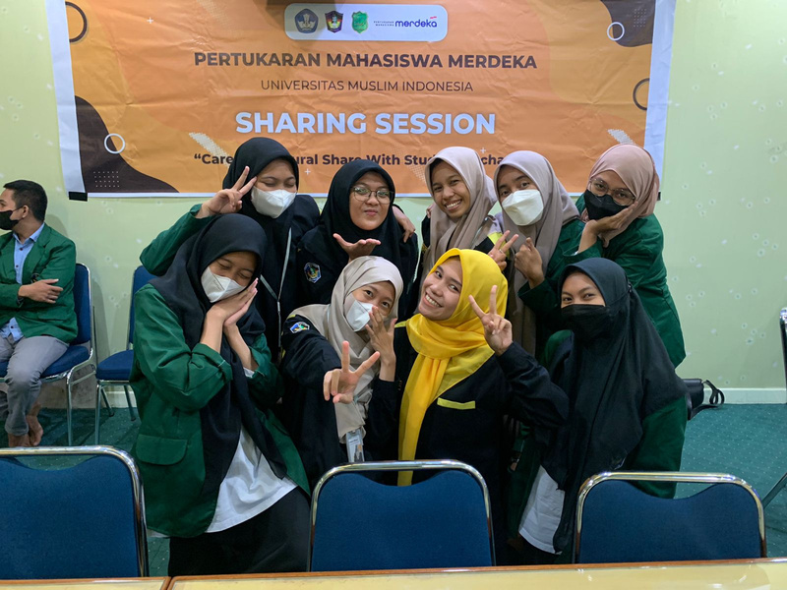
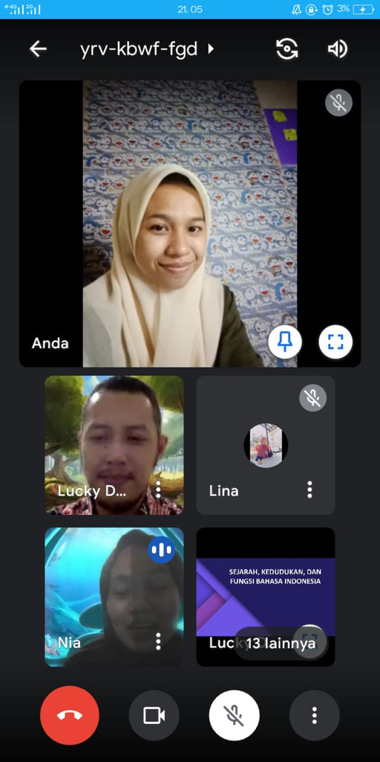
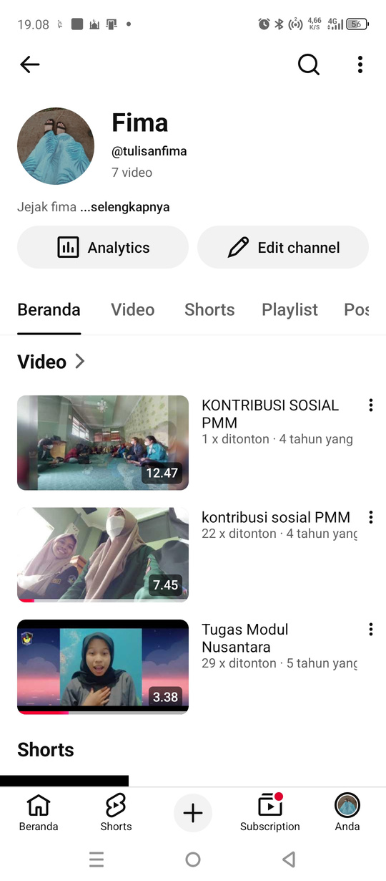
About Me
Education
Skills
Experiences
Organization
Project
Certificate
Contact
PROGRAM MBKM - PERTUKARAN MAHASISWA
Universitas Trunojoyo Madura, Teknik Industri (2021)
Consortium Independent Study 3 College Tall (KMB-3PT), Ministry of Education And Moslem University of Indonesia Culture, (August -
December 2021)
Kompetensi yang dikembangkan
  Communication & Collaboration
  Adaptability
  Critical Thinking
  Problem Solving

Slide 9
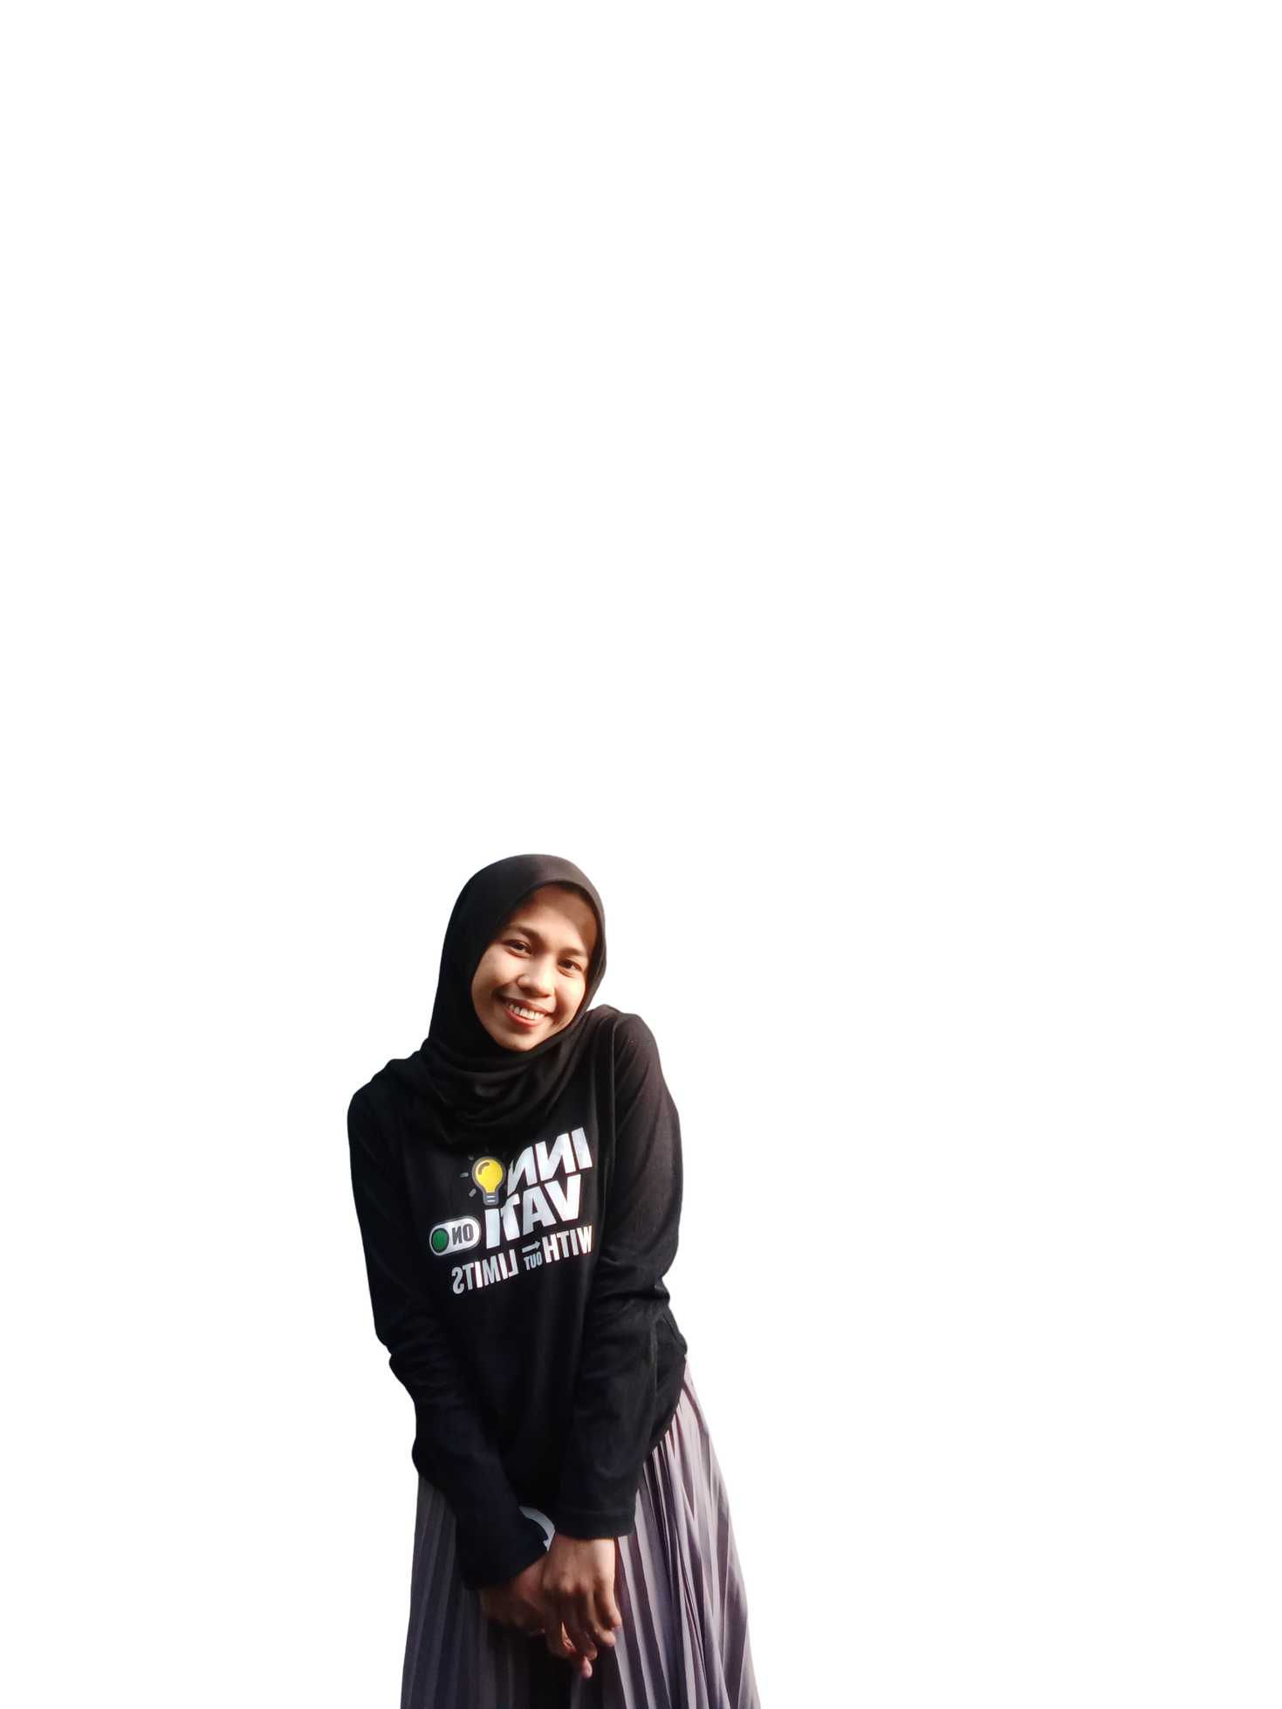
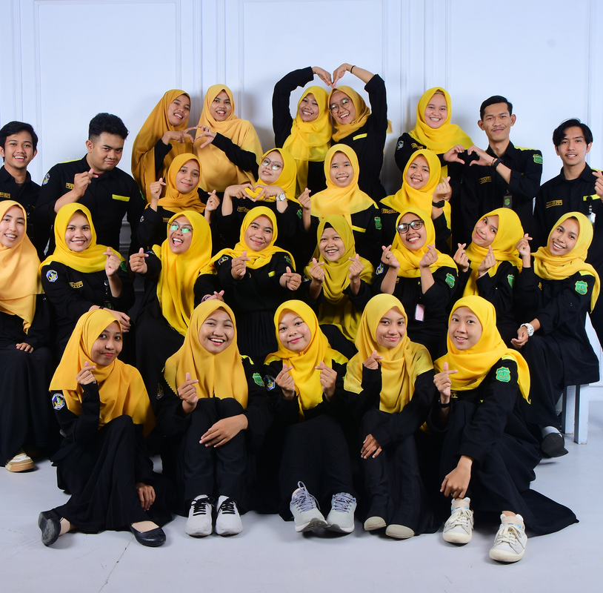

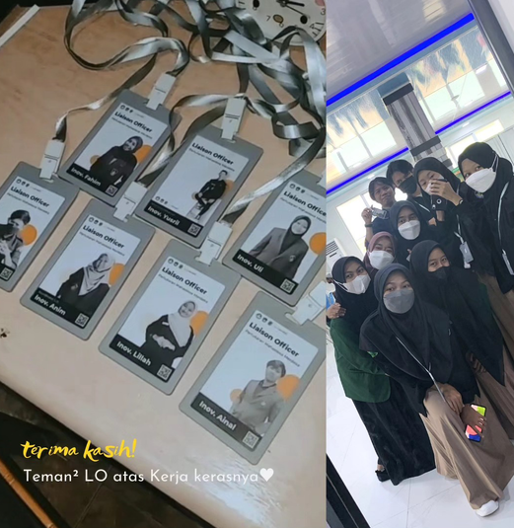
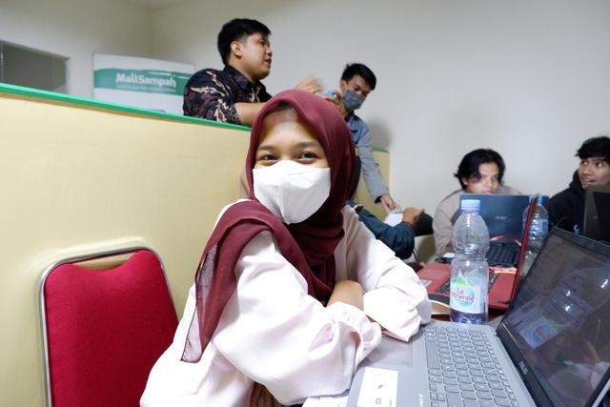
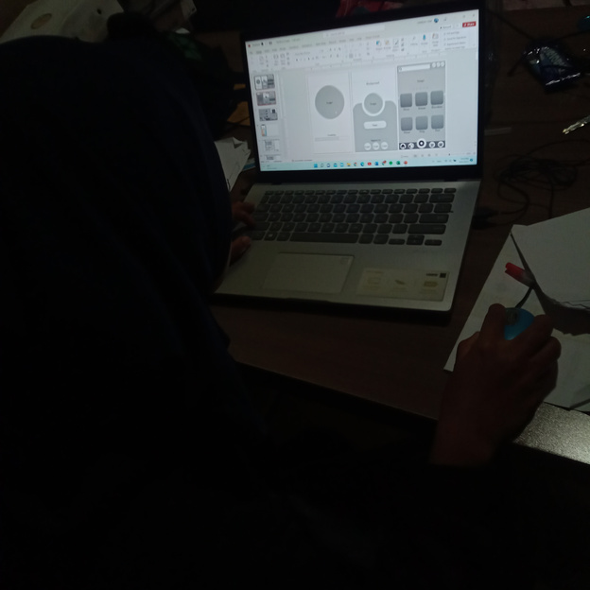
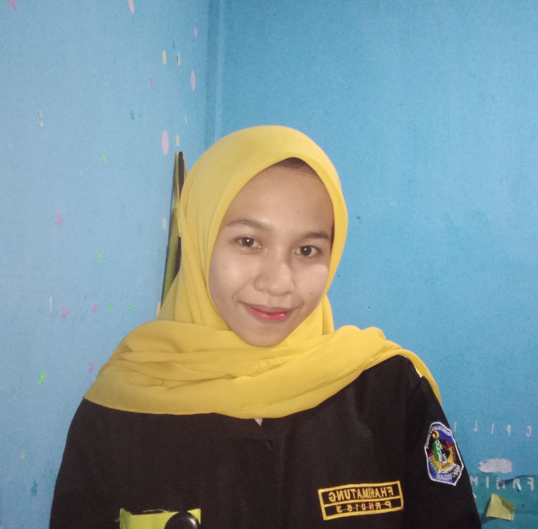
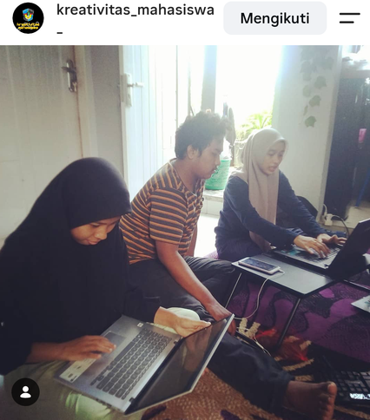
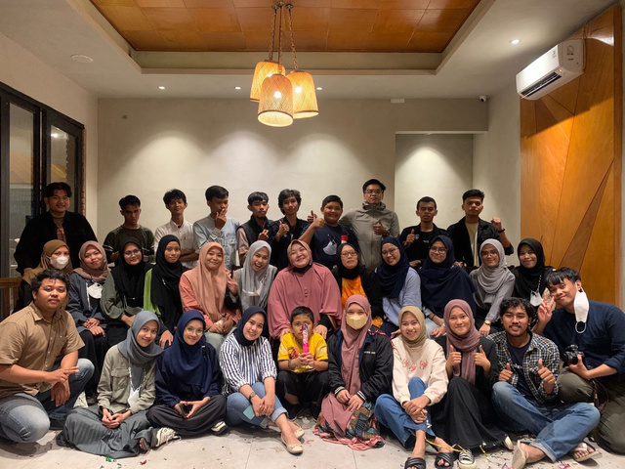
About Me
Education
Skills
Experiences
Organization
Project
Certificate
Contact
PERISAI UMI
STUDY CLUB (PKM)
Anggota Departemen Kompetensi dan Prestasi
Universitas Muslim Indonesia | 2020–2023
  Berpartisipasi dalam kegiatan kelompok studi yang berfokus pada pengembangan ide dan kreativitas mahasiswa melalui Program Kreativitas Mahasiswa (PKM).
  Berkolaborasi dengan tim dalam mengembangkan ide inovatif dan menyusun konsep proposal PKM.
  Mendukung proses diskusi, pengembangan gagasan, dan persiapan kegiatan PKM.
  Berkontribusi dalam program organisasi yang berfokus pada pengembangan kompetensi dan prestasi mahasiswa.
  Membantu perencanaan dan pelaksanaan kegiatan pengembangan mahasiswa.
  Berkolaborasi dengan anggota tim dalam mengoordinasikan program kerja untuk mendukung pencapaian tujuan organisasi.

Slide 10


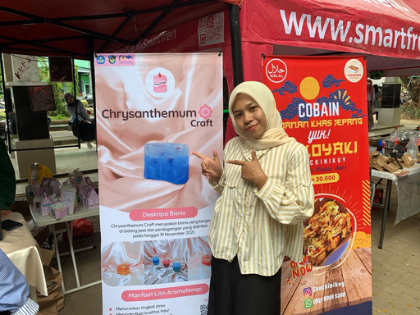
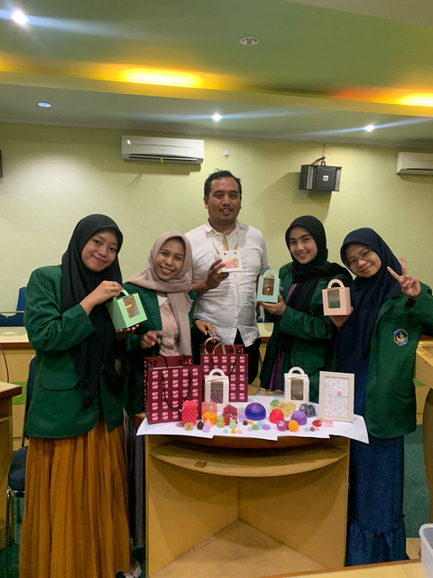
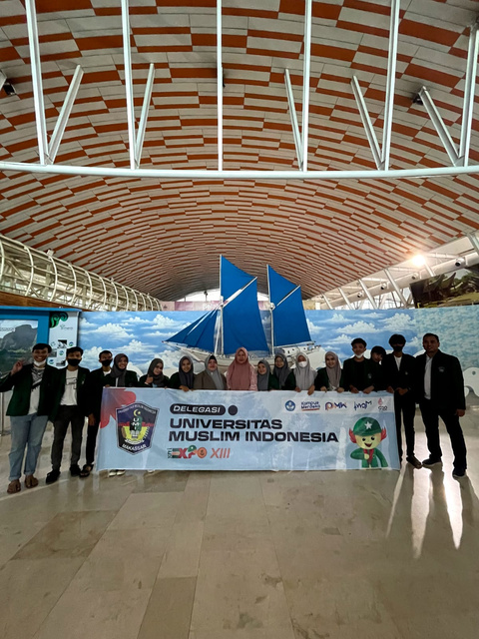
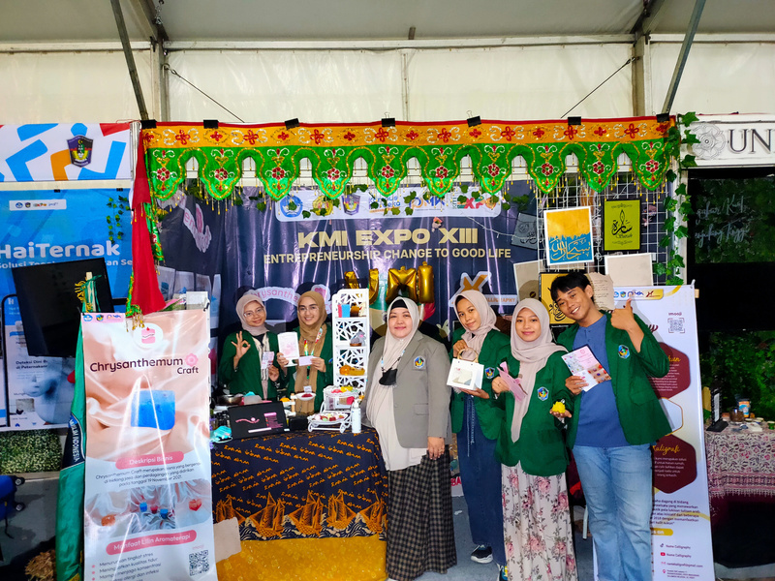

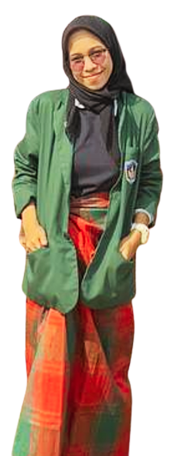
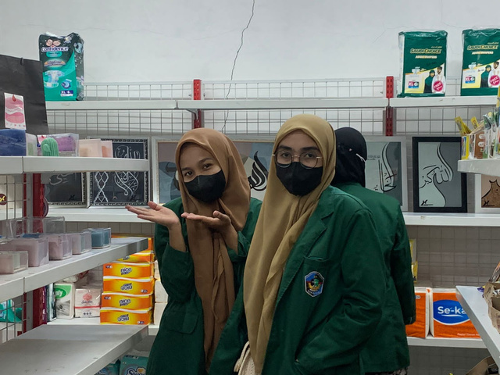
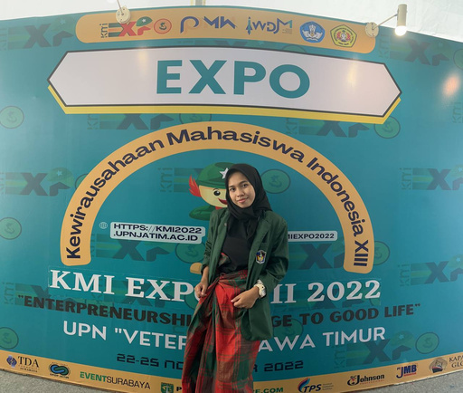
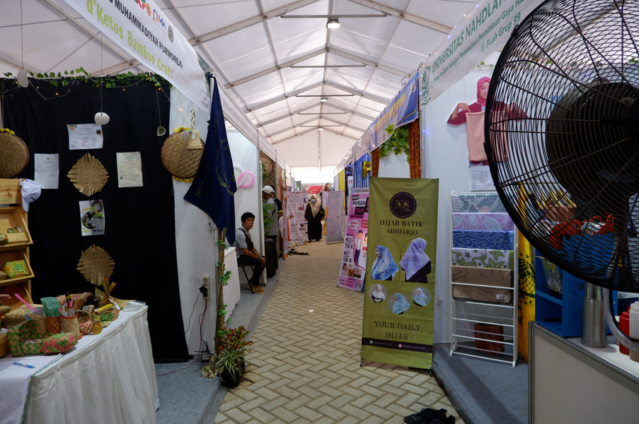
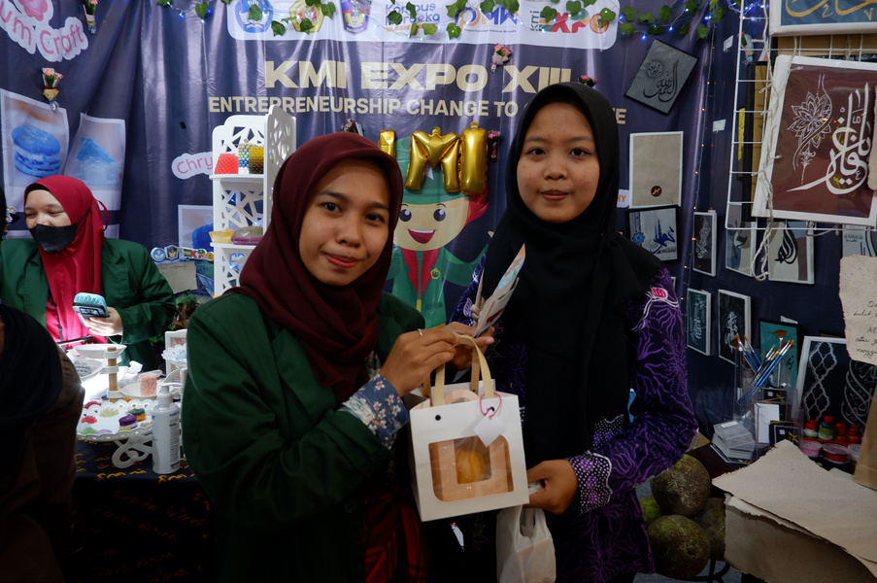
About Me
Education
Skills
Experiences
Organization
Project
Certificate
Contact
PROGRAM PEMBINAAN MAHASISWA WIRAUSAHA (P2MW)
KEWIRAUSAHAAN MAHASISWA INDONESIA (KMI) EXPO XIII
Administrative & Marketing Team Member
Universitas Muslim Indonesia | 2022
Administrative & Marketing Team Member
Universitas Pembangunan Nasional “Veteran” Jawa Timur | 2022
  Mengelola administrasi dan dokumentasi kegiatan usaha.
  Membantu pelaksanaan strategi pemasaran dan promosi produk.
  Mendukung operasional bisnis serta koordinasi antaranggota tim.
  Role: Administration & Marketing Team Member
  Event: KMI Expo XIII 2022
  Responsibilities: Administrative support, business documentation, product promotion, and exhibition coordination.

Slide 11
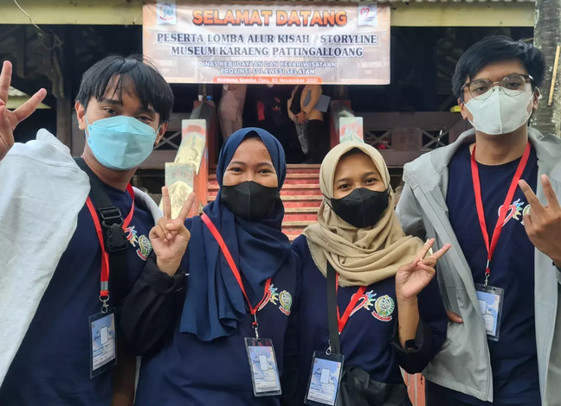
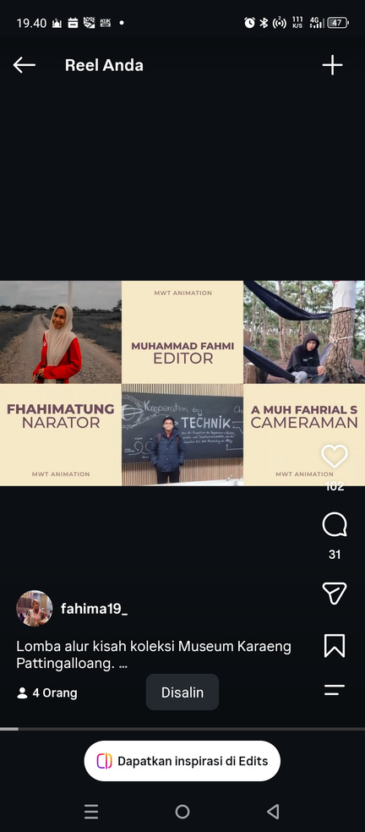
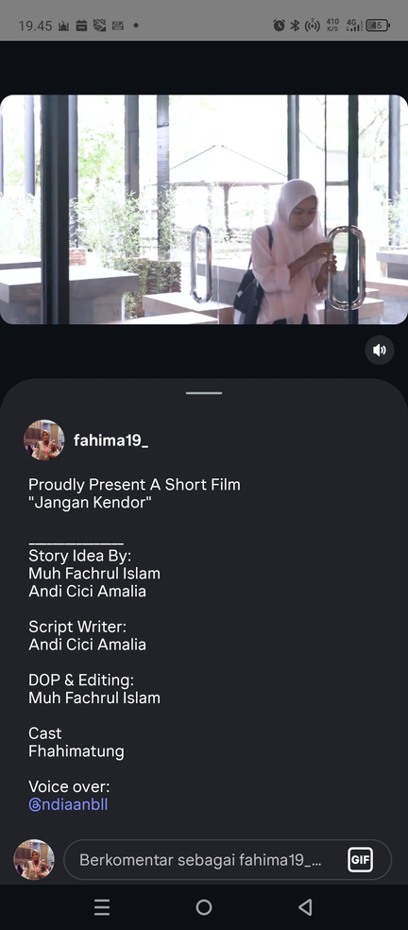
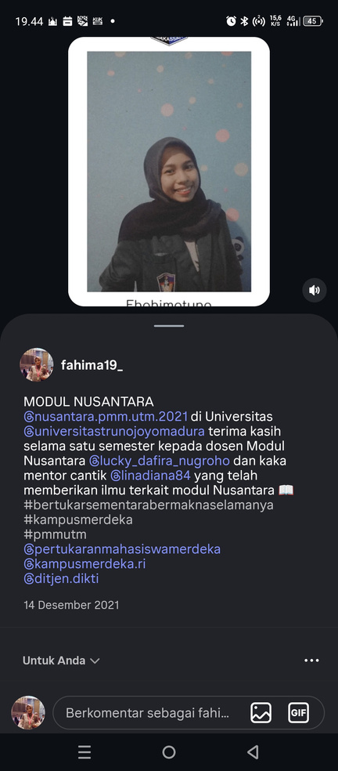
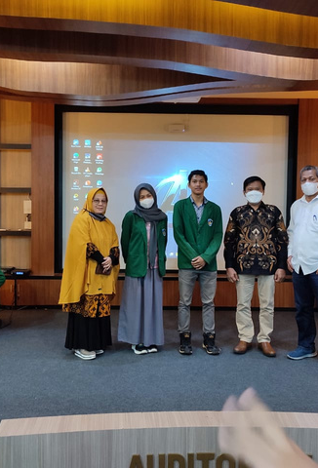
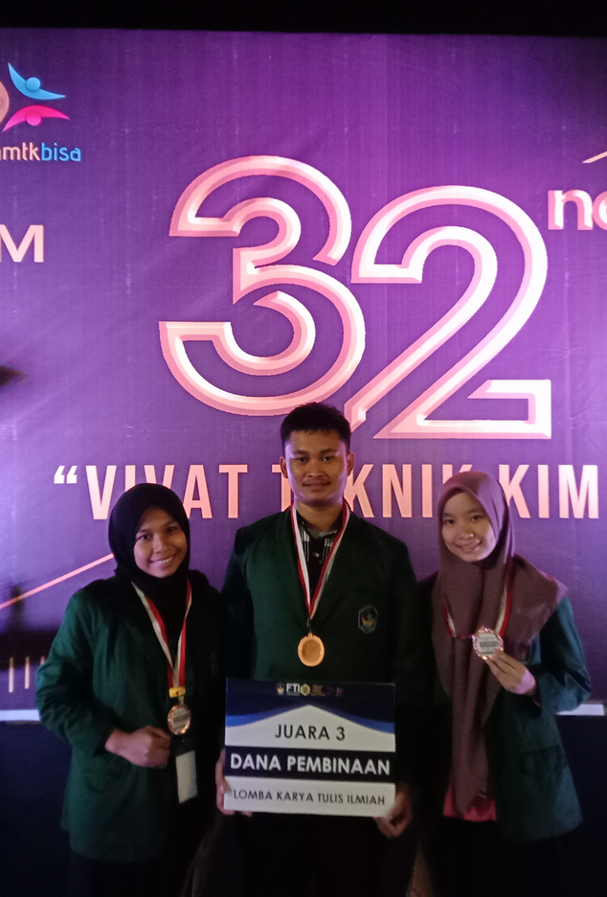


About Me
Education
Skills
Experiences
Organization
Project
Certificate
Contact
PROJECTS & COMPETITIONS

Slide 12
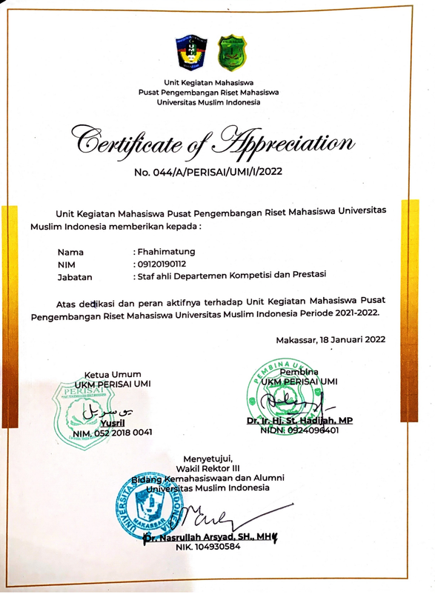







About Me
Education
Skills
Experiences
Organization
Project
Certificate
Contact
CERTIFICATE

Slide 13





About Me
Education
Skills
Experiences
Organization
Project
Certificate
Contact
Work
LET’S
TOGETHER
Let’s Connect
linkedin.com/in/-fhahimatung
+62 815 4349 6763
fhahimatung19@gmail.com

